Slide 1


Physics from data
Ponnam RAHUL 21phe0011​

Slide 2
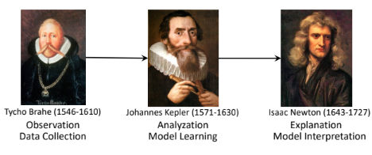
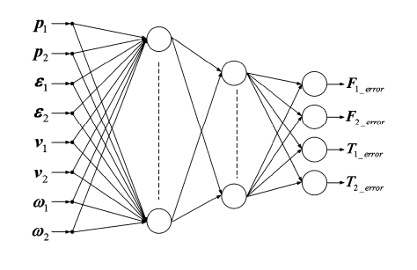
context
Introduction
Relational data
Bacon
Hypothetico-Deductive paradigm
Newton scheme for deep learning

Slide 3
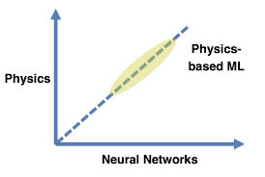
Introduction
What is physics from data?
Machine learning (ML) and artificial intelligence (AI) algorithms are now being used to automate the discovery of physics principles and governing equations from measurement data alone.

Slide 4
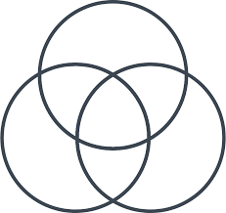
Relational data
Relationship models or relational model data is a type of data, which has relation between the data we have, it is mandatory to have relation between the data points, because if we don’t have any relation between data we cannot develop a concept or particular theory or formulae.

Slide 5
After having a relational data we will use certain ML algorithms to get the exact formulae or concept which was developed by Scientists, generally used algorithms are PINN (Physics Informed Neural Networks), bacon….
Bacon is a relational model developed by Langley and his team in 1970s.
BACON is provided with knowledge of mathematical relationships.
It then searches through the space of possible compositions of those relationships, testing to see how well each one predicts the data.

Slide 6
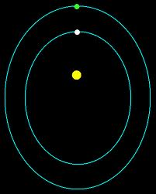
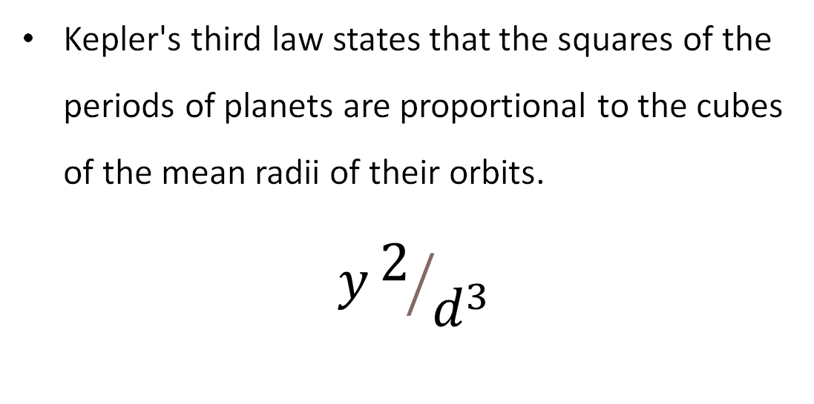
Bacon discovers Kepler's third law
Kepler's third law states that the squares of the periods of planets are proportional to the cubes of the mean radii of their orbits.
$$y2/{d^{3}}$$

Slide 7
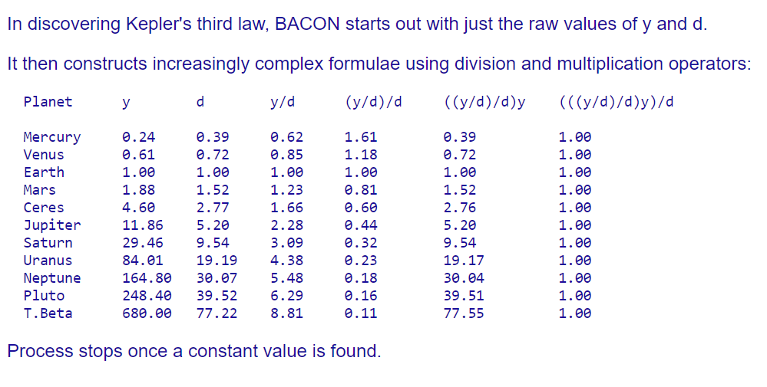
How bacon works
It took Kepler 10 years to discover his laws of planetary motion. BACON was able to discover the same law in a matter of days, because data has the data.

Slide 8
The team behind BACON have created other versions of the program (GLAUBER, STAHL and DALTON et al.) by varying the subset of mathematical relationships used. Provided that the search space used is appropriately customized, the program is guaranteed to succeed, i.e., to `discover' whatever law applies.
The BACON method is sensitive to noisy data and depending how the search is organized, it may also be sensitive to the instantiation and ordering of variables. The big problem is that it requires relationships and variables to be configured so as to ensure that the search succeeds.
This is easy enough where the make-up of the target relationship is known.
However, where the aim is to discover regularities of an unknown form, it may be much more challenging.

Slide 9

Hypothetico-Deductive paradigm
These scientists Tycho, Kepler, Newton are the main source of Kepler’s planetary motion with hypothesis, whereas AI (deep learning) algorithms do not hypothesis.

Slide 10
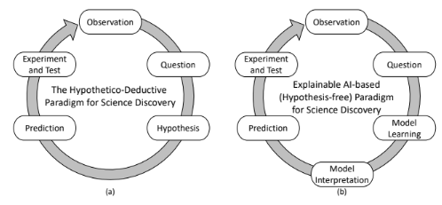
Hypothetico-Deductive paradigm

Slide 11
Newton scheme for deep learning
To solve the Newton physics problem in NNs, we first take the typical MLP (Multilayer perceptron) methodology. This is to use NNs (neural networks) to depict a function x=f(t), which can only accomplish the historical fitting part other than the forecast future movement.
However, divide the MLP structure into two parts as the input/output layers connected by the hidden layers as [f1(t) f2(t) f3(t) ... fn(t)] ∗ [w1 w2 w3 ... wn], here [f1(t) f2(t) f3(t) ... fn(t)] is the values in the last layer, the MLP network can provide the prediction ability through the polynomial function with activation function, as shown in Figure 1.

Slide 12
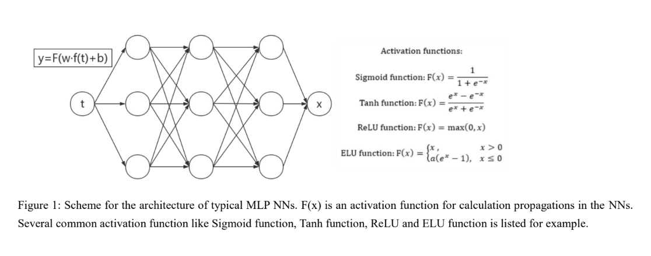
the activation function can introduce the nonlinear correlations. Other typical NNs architecture like TCN(Temporal Convolutional Networks), GRU(Gated Recurrent Units) shares the same linear basis feature, similar to the MLP methodology, because the architecture is strongly restricted by the polynomial calculation rules.

Slide 13
APPLICATIONS
The AI technology is widely applied in the sports field, such as table tennis, ice hockey etc. The prediction of
movements is crucial in many aspects, one of which is the training exercise in professional sports like table tennis. Let us take soccer for example, by integrating the techniques and the desired ball trajectory, players can find the right way to score a goal. When a player hitting a ball, it is essential to forecast the ball’s location, which is easy when the ball is not spinning. However, in most situations, the ball is flying with a self-spinning, resulting in a Magnus force on it, which makes it difficult to predict the position by traditional methods. Here we demonstrate that the NS scheme can work out to predict more complicated classic physics system, like magnus force in soccer.

Slide 14

Curve - angle relationship
$θ\left(t\right)= θ0+\left(\frac{λ.S}{τ}\right)t$ _{Eq(3)}
S(t) = L.log ((t/τ)+ 1) Eq (4)
where θ₀ is the initial angle of velocity,
λ = 4C_{n}/C_{D}, C_{n} and C_{D} are two parameters provided by experiments,
S = Rω₀/v_{0,xy} is the spin parameter,
L is the characteristic penetration length..

Slide 15
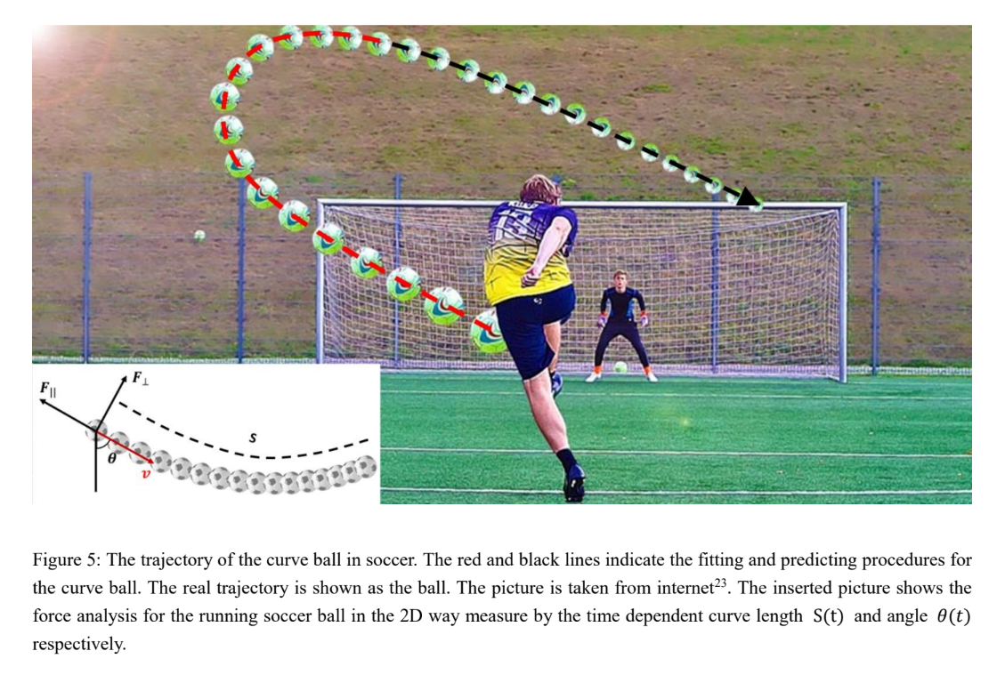

Slide 16

Science advances in ai: ai feynman
The AI Feynman method, which uses symmetry and minimum description length, has the potential to bridge the gap between neural networks and physics, and can be used to solve complex problems and discover new equations. It was able to discover over100 equations from the famous Feynman lectures on physics, showcasing its potential in solving complex problems.

Slide 17
Overall algorithm
Generic functions f(x1, ..., xn) are extremely complicated and near impossible for symbolic regression to discover. However, functions appearing in physics and many other scientific applications often have some of the following simplifying properties that make them easier to discover:
Units: f and the variables upon which it depends have known physical units.
Low-order polynomial: f (or part thereof) is a polynomial of low degree.
Compositionality: f is a composition of a small set of elementary functions, each typically taking no more than two arguments.
Smoothness: f is continuous and perhaps even analytic in its domain.
Symmetry: f exhibits translational, rotational, or scaling symmetry with respect to some of its variables.
Separability: f can be written as a sum or product of two parts with no variables in common.

Slide 18
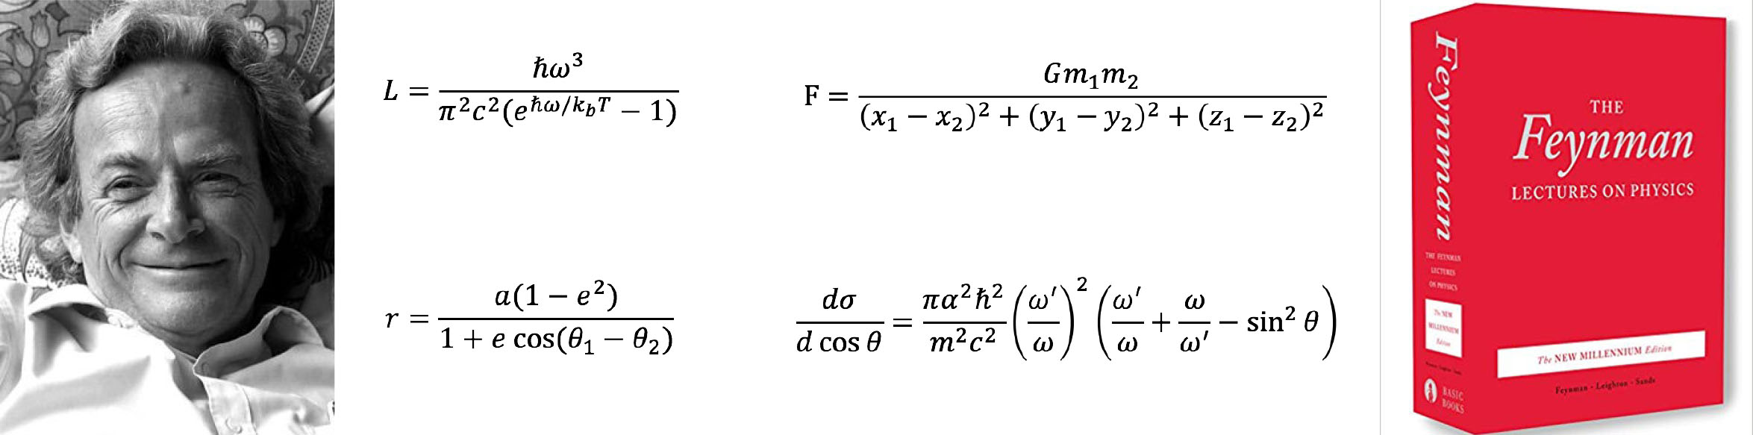
Neural network training
To obtain an interpolating function for a given mystery, we train a neural network to predict the output given its input. We train a feed-forward, fully connected neural network with six hidden layers with soft plus activation functions, the first three having 128 neurons and the last three having 64 neurons. For each mystery, we generated 100,000 data points, using 80% as the training set and the remainder as the validation set, training for 100 epochs with learning rate 0.005 and batch size 2048. We use the rms error loss function and the Adam optimizer with a weight decay of 10−2

Slide 19
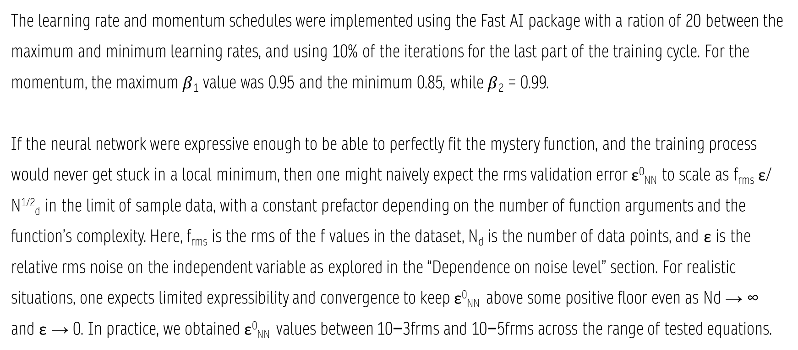
The learning rate and momentum schedules were implemented using the Fast AI package with a ration of 20 between the maximum and minimum learning rates, and using 10% of the iterations for the last part of the training cycle. For the momentum, the maximum $β$₁ value was 0.95 and the minimum 0.85, while $β$₂ = 0.99.
If the neural network were expressive enough to be able to perfectly fit the mystery function, and the training process would never get stuck in a local minimum, then one might naively expect the rms validation error ε⁰_{NN} to scale as f_{rms} ε/ N^{1/2}_{d} in the limit of sample data, with a constant prefactor depending on the number of function arguments and the function’s complexity. Here, f_{rms} is the rms of the f values in the dataset, N_{d} is the number of data points, and ε is the relative rms noise on the independent variable as explored in the “Dependence on noise level” section. For realistic situations, one expects limited expressibility and convergence to keep ε⁰_{NN} above some positive floor even as Nd → ∞ and ε → 0. In practice, we obtained ε⁰_{NN} values between 10−3frms and 10−5frms across the range of tested equations.

Slide 20
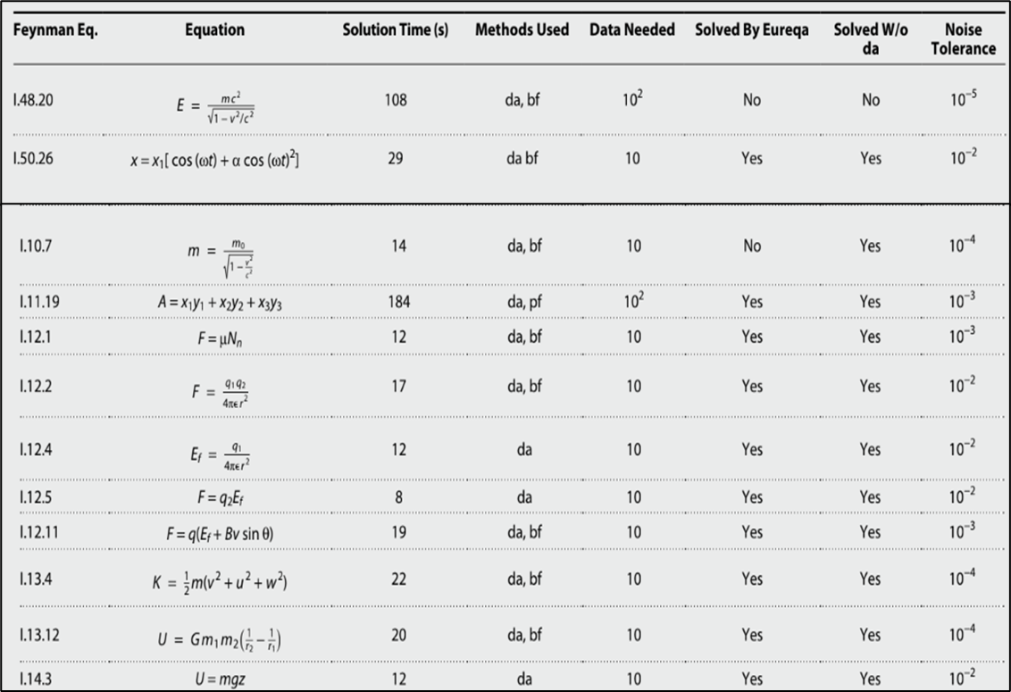

Slide 21
Thank you

